Slide 1

Note: The data and information in this document is reflective of a hypothetical situation and client. This document is to be used for KPMG Virtual Internship purposes only.
Sprocket Central Pty Ltd
Data analytics approach
[Division Name] - [Engagement Manager], [Senior Consultant], [Junior Consultant]

Slide 2
Note: The data and information in this document is reflective of a hypothetical situation and client. This document is to be used for KPMG Virtual Internship purposes only.
Agenda
Data Exploration
Model Development
Interpretation

Slide 3
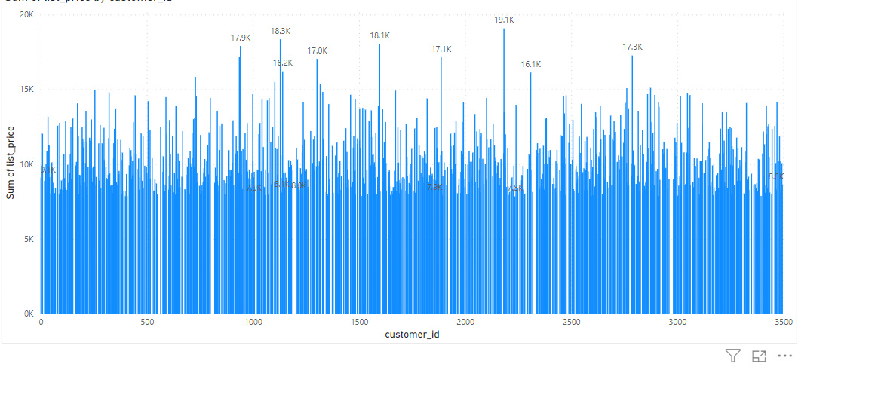
Note: The data and information in this document is reflective of a hypothetical situation and client. This document is to be used for KPMG Virtual Internship purposes only.
Data Exploration
Place headline insight or information here. This should be the most important point for this slide.
Evaluated the list pricing for the consumers. Based on gender, age, and tenure, the data set is analyzed. Identified the relevant features for analysis, such as customer address and tenure
Transformed data by handling missing values, outliers, and inconsistencies.
Place any supporting images, graphs, data or extra text here.

Slide 4
Note: The data and information in this document is reflective of a hypothetical situation and client. This document is to be used for KPMG Virtual Internship purposes only.
Model Development
Place headline insight or information here. This should be the most important point for this slide.
Choosing a effective machine learning model, such as logistic regression, decision trees, or random forests, based on the nature of the problem and the available data.
Train the selected models using the training dataset.
Fine-tune the models by adjusting hyper-parameters or trying different algorithms.

Slide 5
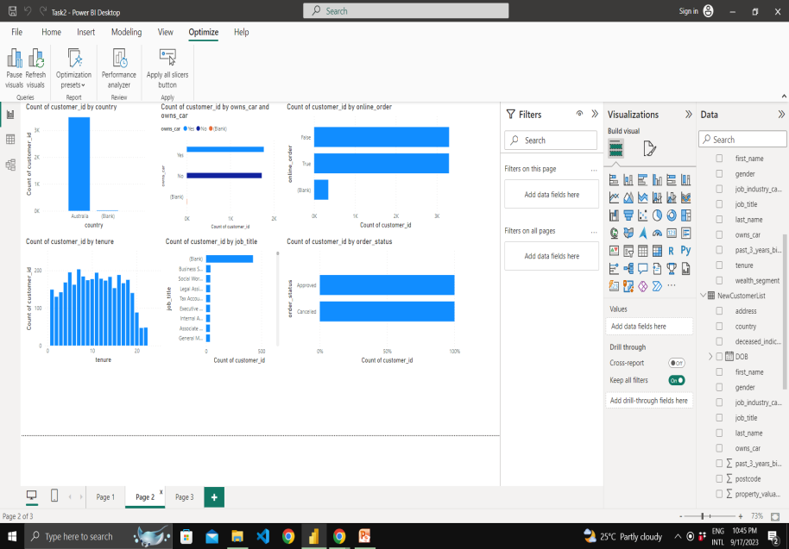
Note: The data and information in this document is reflective of a hypothetical situation and client. This document is to be used for KPMG Virtual Internship purposes only.
Interpretation
Place headline insight or information here. This should be the most important point for this slide.
Use the trained models to predict the target variable for the new customer dataset.
Rank the new customers based on their predicted value or likelihood to make a purchase.
Create a PowerPoint
Use visual aids like charts, graphs, and tables to present the findings in a clear and concise manner.
Place any supporting images, graphs, data or extra text here.

Slide 6
Note: The data and information in this document is reflective of a hypothetical situation and client. This document is to be used for KPMG Virtual Internship purposes only.
Appendix

